Slide 1

Vel Tech Rangarajan Dr. Sagunthala R&D Institute of Science and Technology
School of Computing
Department of Computer Science and Engineering
10211CS224 / FULL STACK APPLICATION DEVELOPMENT (JAVA)
PROJECT REVIEW : MILESTONE PROJECT – 1
Date: 24-03-2026
Responsive E-Commerce Interface With State –Persistent Cart
SDG: SDG 9-Industry,Innovation and Infrastructure
Presented By:
AVVARU AISHWARYA– VTU26635 – 23UECS0669
Courses Handling Faculty:
Dr.Hafizur Rahman-Assistant Professor

Slide 2
INTRODUCTION
1
This project focuses on developing a responsive e-commerce web application that allows users to browse and purchase products online. Many traditional systems lack responsiveness and fail to retain user cart data after page refresh. This project solves that problem by implementing a state-persistent cart system. The application adapts to different screen sizes such as mobile, tablet, and desktop. It provides a smooth shopping experience with user-friendly navigation. The system uses modern web technologies to ensure efficiency and usability. This project is relevant in real-world online shopping platforms. It demonstrates frontend and backend integration. One of the major issues faced by users is the loss of cart data during page refresh or session expiry. This project presents a modern solution by developing a responsive e-commerce interface integrated with a state-persistent cart system. The application ensures that users can continue their shopping experience without interruption.
2
3
4
5
6
7
8
9

Slide 3
PROBLEM STATEMENT
1
In many existing e-commerce systems, cart data is lost when the page is refreshed or the browser is closed. This creates inconvenience for users and reduces user experience. Additionally, some systems are not responsive and do not work properly on different devices. Manual handling of cart data leads to inefficiency and errors. There is a need for a responsive and automated system that can maintain cart state persistently. The system should provide a seamless shopping experience across all devices. The challenge lies in maintaining cart data persistently while ensuring fast performance and secure handling of user information.
2
3
4
5
6
7
8
9

Slide 4
OBJECTIVE(S)
1
To design and develop a responsive e-commerce web interface.
To implement a state-persistent cart using local storage/database.
To enhance user experience through seamless interaction and navigation.
2
3
4
5
6
7
8
9

Slide 5
PROPOSED SYSTEM
1
User accesses the application through a web browser.
Authentication is performed(login/register).
Product data is fetched and displayed dynamically.
User interacts with products and adds items to the cart.
Cart state is preserved using persistent storage.
Improved user experience and performance.
Persistent cart using local Storage/database.
Responsive web design for all devices.
2
3
4
5
6
7
8
9

Slide 6
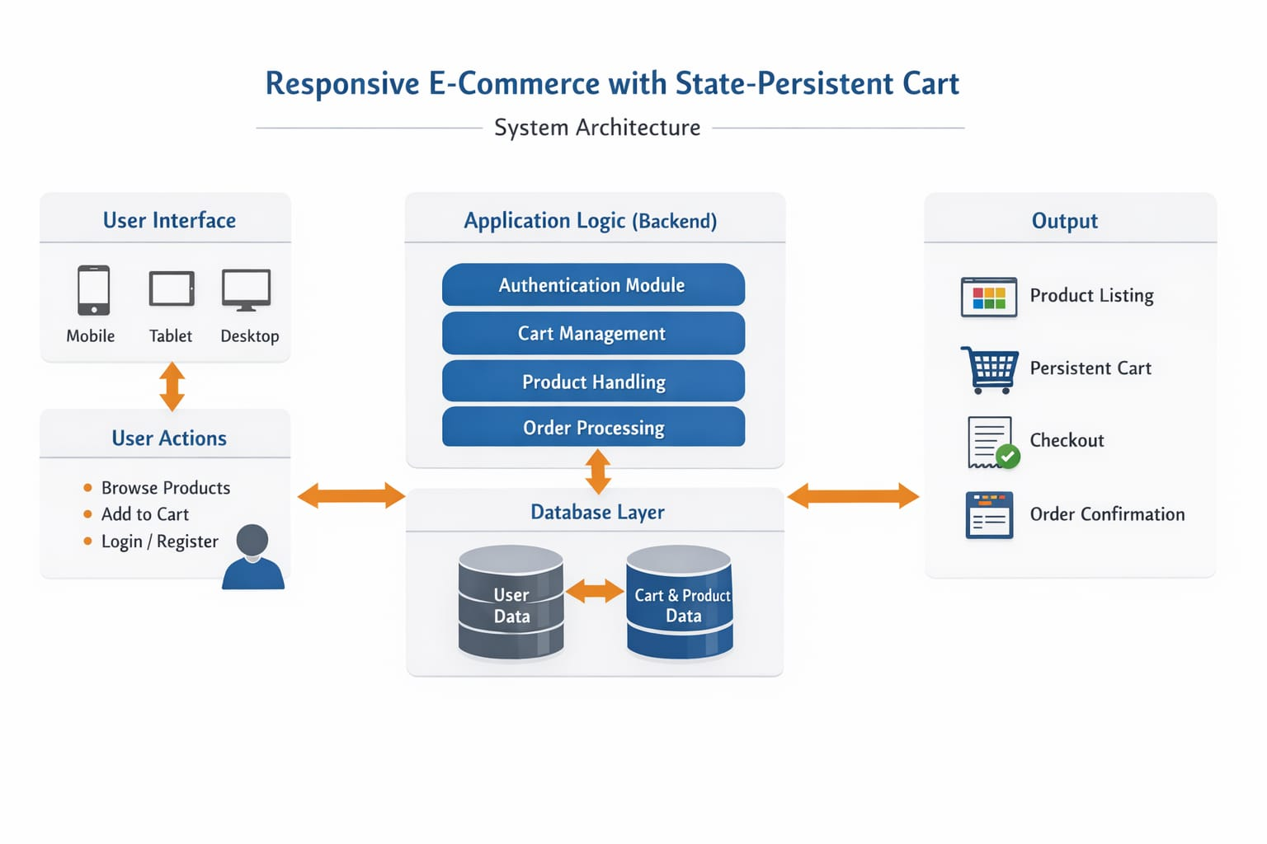
PROPOSED SYSTEM ARCHITECTURE
1
2
3
4
5
Input: User selects products and login details.
Processing: Data handled using PHP/JavaScript logic.
Database: Stores user and product details (MySQL).
Output: Displays products, cart items, and total price.
6
7
8
9

Slide 7
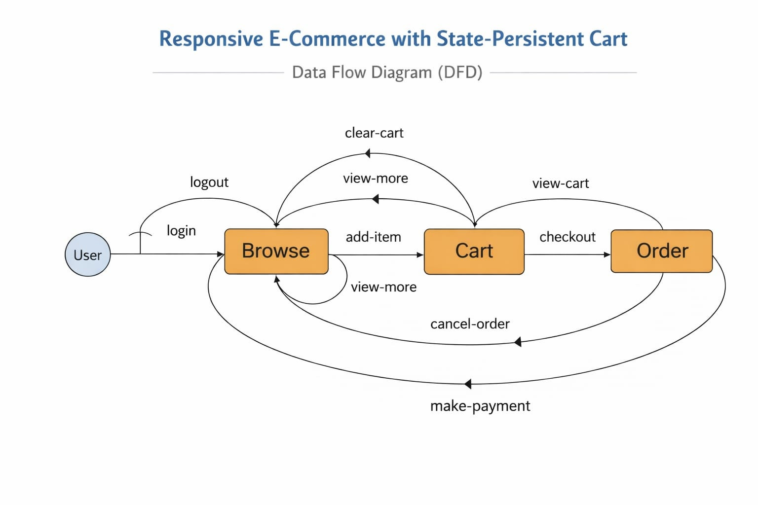
WORKFLOW
1
2
3
4
5
6
7
8
9

Slide 8
TECHNOLOGIES USED
1
Frontend: HTML, CSS, JavaScript.
Backend: PHP.
Database: MYSQL.
Tools: XAMPP, VS Code.
Hardware/Software Requirements: Computer with a browser.
2
3
4
5
6
7
8
9

Slide 9
MODULE DESCRIPTION
1
Module 1: User Management
Handles user registration, login and logout sessions.
Module 2: Product Management
Displays product list with images and price.
Module 3: Cart Management
Allows adding, removing, and updating cart items with persistent storage.
Module 4: Checkout System
Collects user details and confirms order placement.
2
3
4
5
6
7
8
9

Slide 10
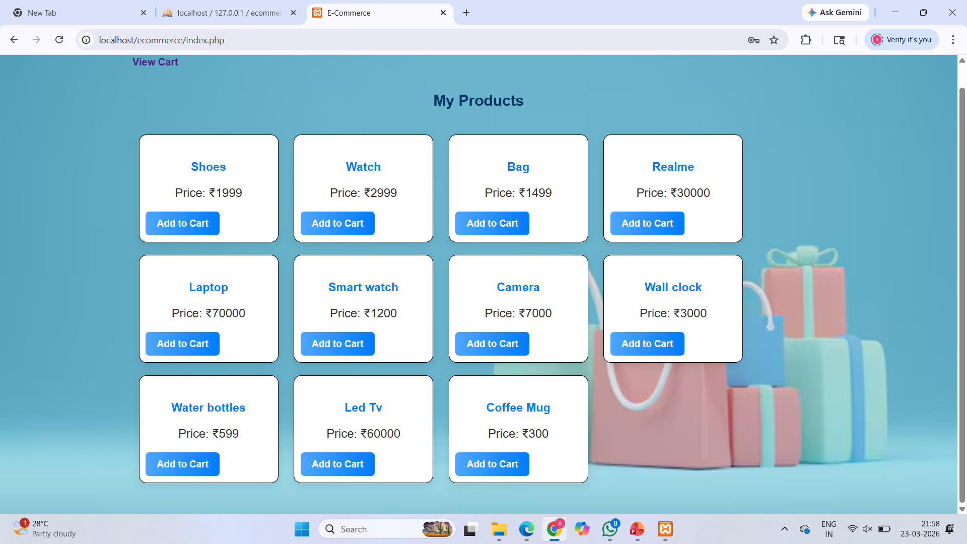
IMPLEMENTATION SCREENSHOTS
1
2
3
4
5
6
7
8
Home page: It displays all available products, including their names and prices, in a structured layout. Users can browse items and add them to the cart using the “Add to Cart” button.
9

Slide 11
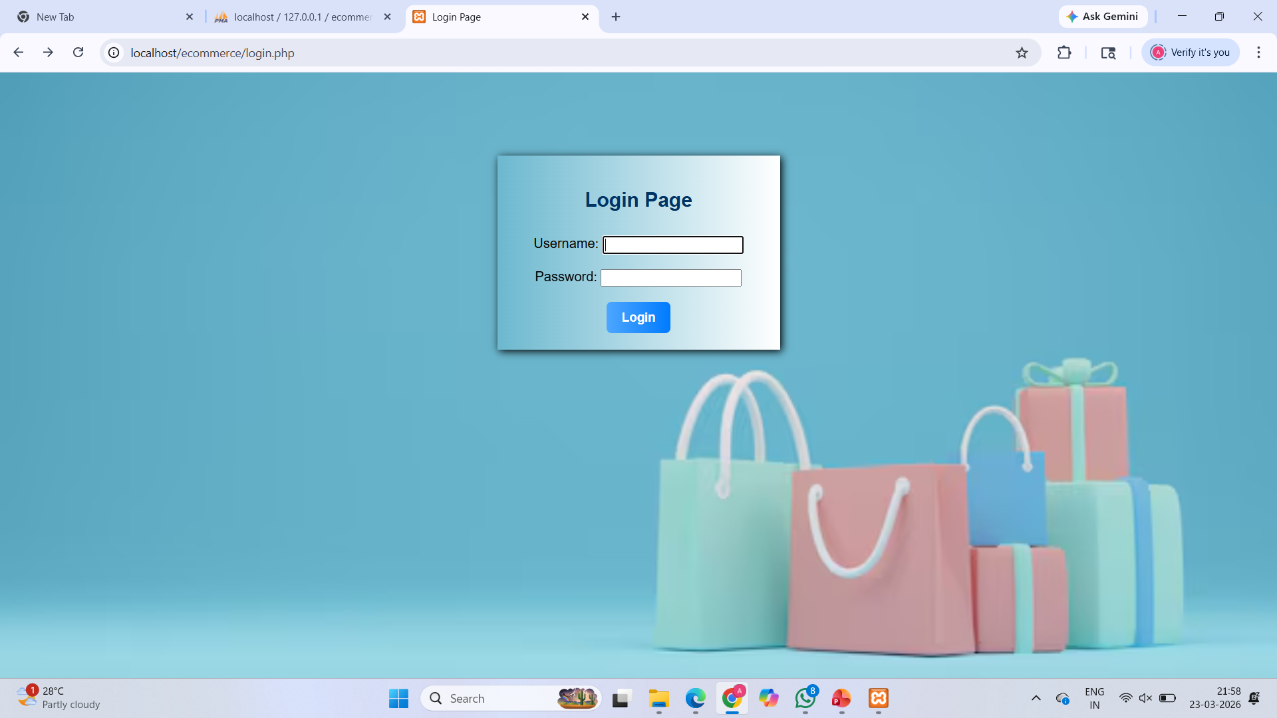
IMPLEMENTATION SCREENSHOTS
1
2
3
4
5
6
7
8(A)
Login page: The login page allows users to securely access the system by entering their email and password, verifies user credentials and redirects them to the main shopping page upon successful login.
:
9

Slide 12
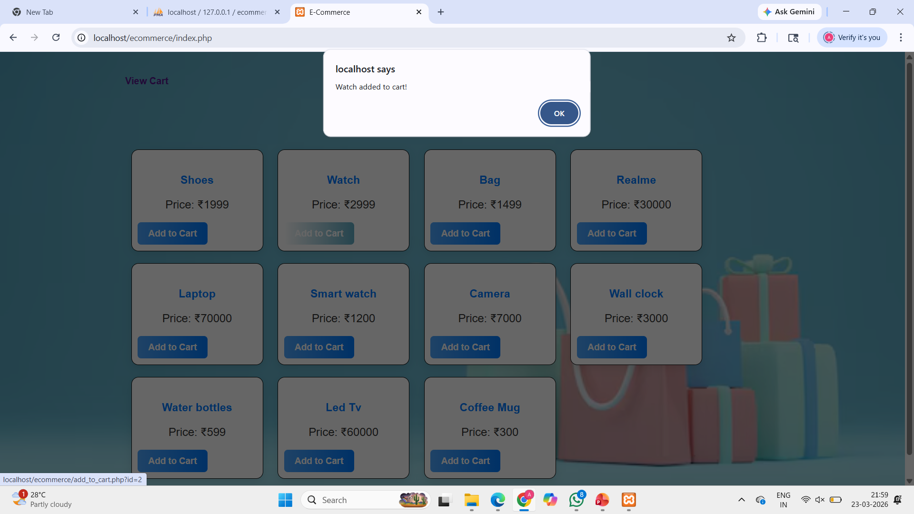
IMPLEMENTATION SCREENSHOTS
1
2
3
4
5
Main Module: Each product includes details such as name and price, along with an “Add to Cart” option. Users can browse through different products and select items to add to their shopping cart.
6
7
8(B)
9

Slide 13
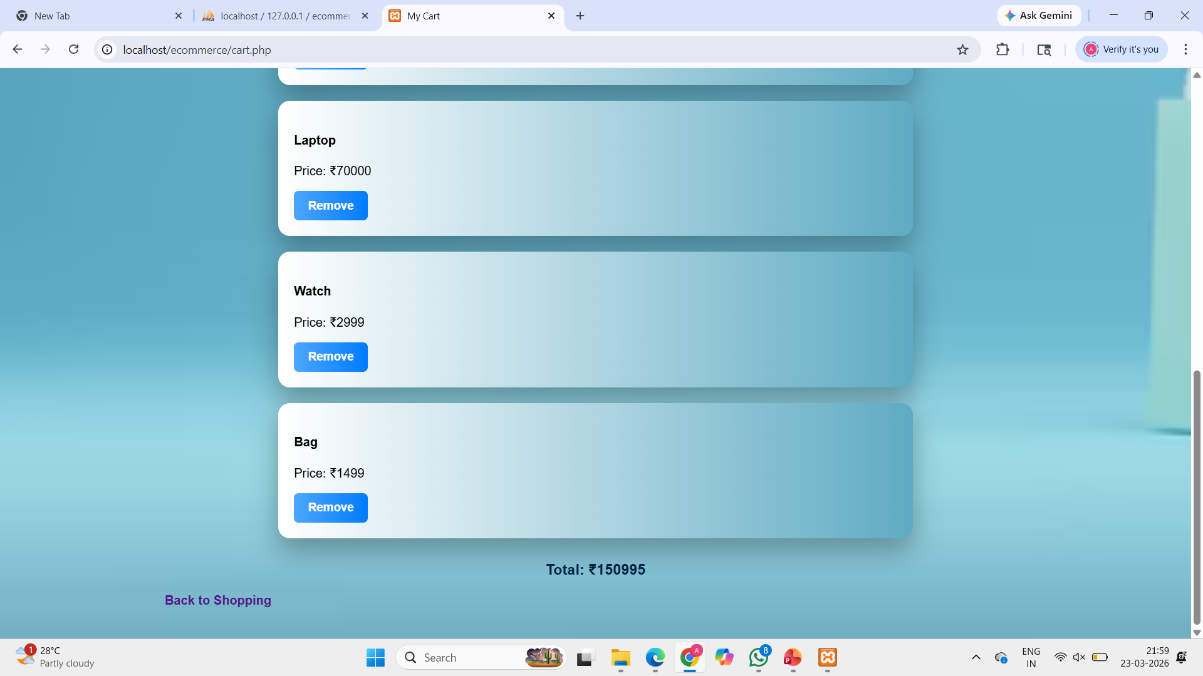
IMPLEMENTATION SCREENSHOTS
Output page: This is the final output page of the application where all selected products are displayed in the shopping cart. It shows product details along with the total price calculated automatically based on user selections. Users can also remove items from the cart before finalizing their purchase.
1
2
3
4
5
6
7
8(C)
9

Slide 14
ADVANTAGES & LIMITATIONS
1
ADVANTAGES:
User-friendly interface.
Works on all devices.
Cart data is not lost after refresh.
Fast and efficient system.
Improve user experience.
LIMITATIONS:
No online payment integration.
Limited product database.
Basic security implementation.
2
3
4
5
6
7
8
9

Slide 15
Thank you

